Slide 1
VICTORIA CRIME DATA ANALYSIS
Team MEMBERS : HEEJUN SEO, SHERIN THOMAS, NEENA MANI (Group 3)

Slide 2
PROJECT BRIEF
Our project aimed to look at available data for Crime Incidents across Victoria for the past five years from 2017 to 2021 to identify the safest LGAs (Local Government Areas) in Victoria. Specifically, we looked at:
Geo Spatial mapping of the crime rates across the 79 LGAs in Victoria
Top 10 LGAs in Vitoria with lowest crime rates
Top 10 LGAs in Victoria with highest crime rates
What are the most common offence types under the crime incidents
How the crime rates by offence types have changed over the years from 2017 to 2021
Breakdown of the Family Crime Victims based on gender and age
Notes:
met to establish some questions for them to answer (read dot point four) and wanted them to look at client data over a 10 year period.

Slide 3

APPROACH
Notes:
Last year, after trying to get a program going with RMIT, we ended up getting together with a group of senior Data Analytics students, who were trying to establish a real world project with NFPs

Slide 4
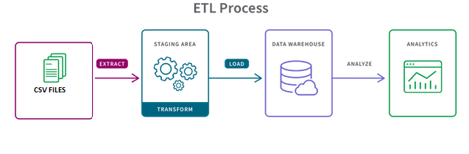
ETL (Extract, TRANSFORM, LOAD) PROCESS
Data Files : CSV Files
Data Cleaning : Python
Data Loading : MongoDB, Python Flask–powered API
Data Visualization : JavaScript, HTML, Plotly, Leaflet
Data Used :
There were two datasets used for this project from https://www.crimestatistics.vic.gov.au/crime-statistics/latest-victorian-crime-data/download-data
Data_Tables_LGA_Criminal_Incidents_Year_Ending_March_2021
This file contains the crime incidents recorded and the crime rate per 100,000 population for each of the 79 LGAs for the time period 2012 - 2021
It also contains the crimes categorised by offence types
CSV File
Data_Tables_Family_Incidents_Visualisation_Year_Ending_March_2021
This file contains the Family Crimes Victim data categorized by Gender and Age for the period 2017 - 2021
CSV file
Notes:
Last year, after trying to get a program going with RMIT, we ended up getting together with a group of senior Data Analytics students, who were trying to establish a real world project with NFPs

Slide 5
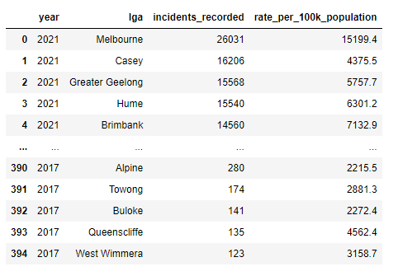
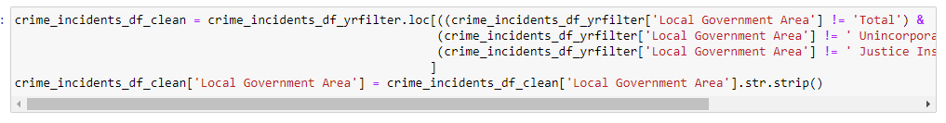
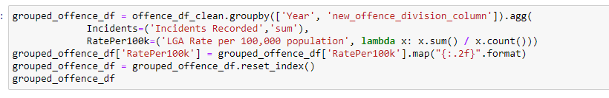
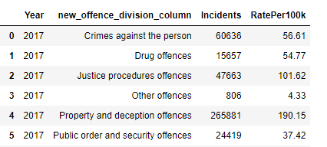
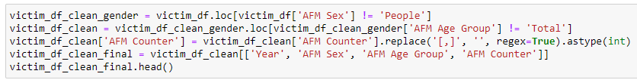
DATA TRANSFORM
The data was cleaned using Python and only the required fields were selected.
Notes:
met to establish some questions for them to answer (read dot point four) and wanted them to look at client data over a 10 year period.

Slide 6
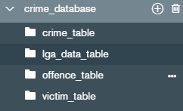
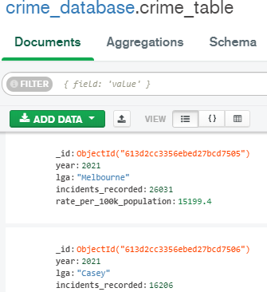
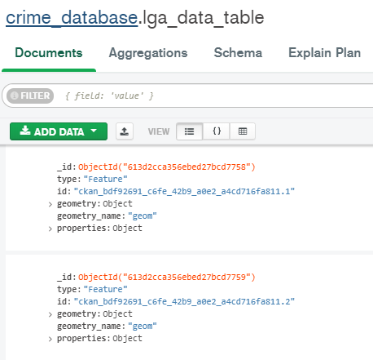
DATA LOAD
The transformed data was loaded into Mongo DB under database crime_database with 4 collections as shown
Notes:
met to establish some questions for them to answer (read dot point four) and wanted them to look at client data over a 10 year period.

Slide 7
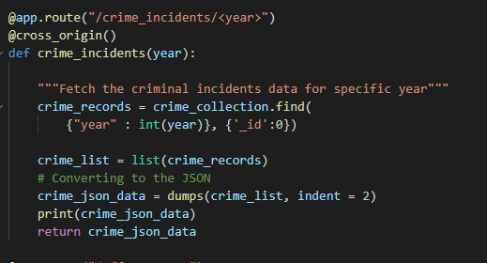
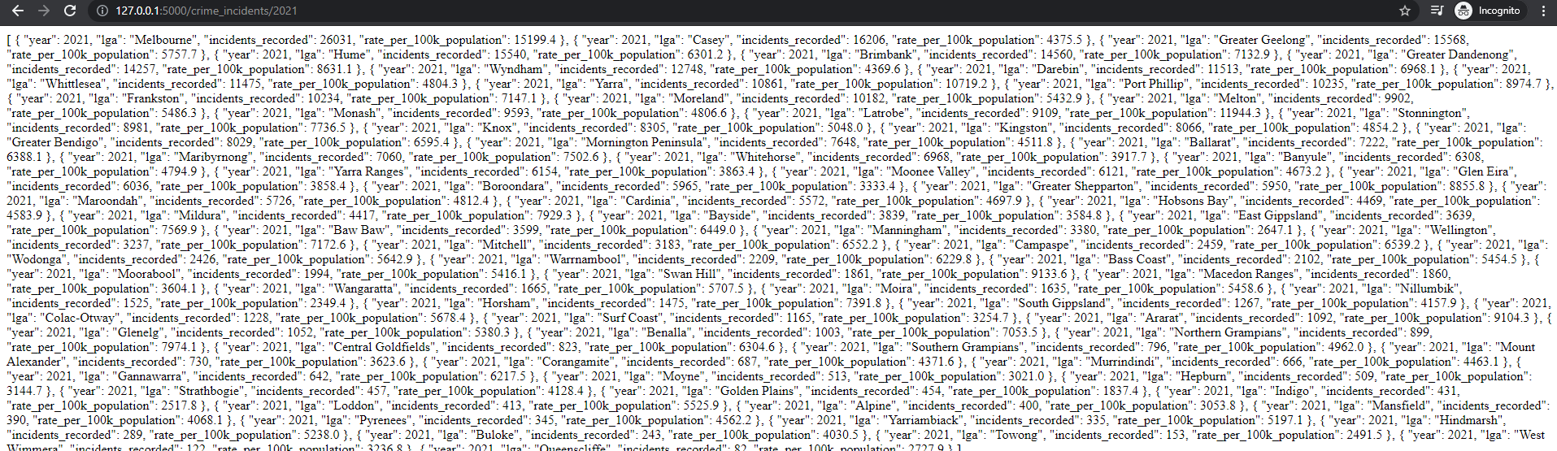
API – PYTHON FLASK POWERED API
The data from the 4 MongoDB collections were converted to JSON format and loaded into APIs using the Flask Application
Notes:
met to establish some questions for them to answer (read dot point four) and wanted them to look at client data over a 10 year period.

Slide 8
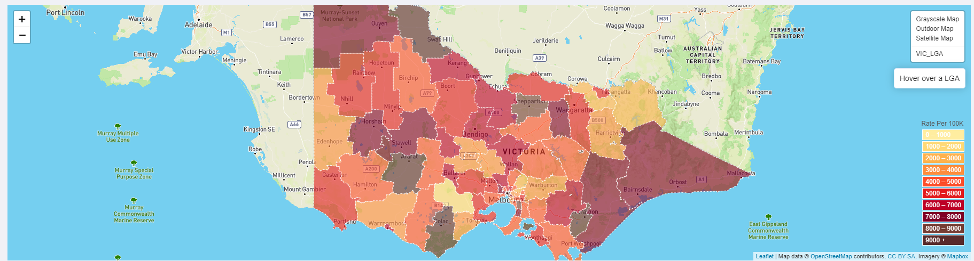
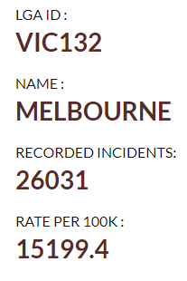
GEO spatial representation of crime rates
Gender:
Notes:
Note that all this data will relate to services, not clients, so in others words, read the percentages as a percentage of total service so 32% of our services are to female clients, while 68% are to men.
(go through data)
Median age
Top matters
Duty lawyer predominant service type, Crim dominant program
From Casey, Hume, Greater Geelong
Approx. two thirds of services to men, a third to women.
Co-occurring legal probs include FV and family law/child protection

Slide 9
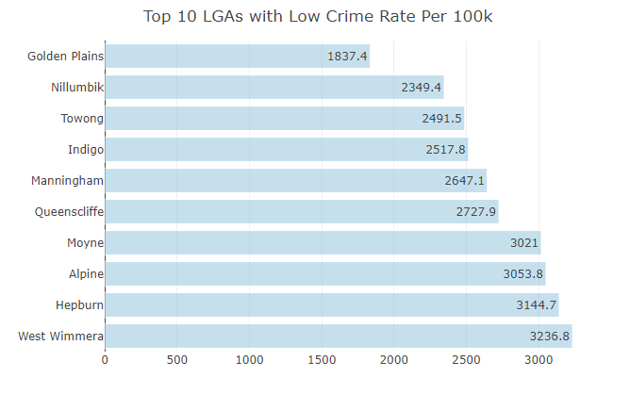
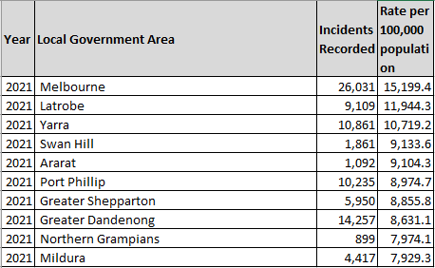
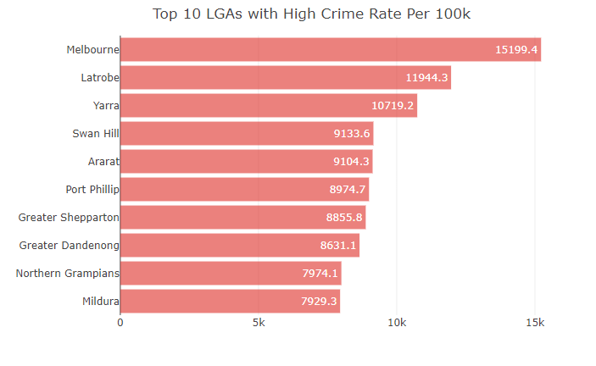
TOP 10 lgas With most and least crimes
Top 3 LGAs with Maximum Crime Rates
Melbourne
LaTorbe
Yarra
Top 3 LGAs with Least Crime Rates
Golden Plains
Nilumbik
Towong
Gender:
Notes:
Note the differences in this group compared with the “all VLA” group
Higher percentage of services going to females
Protection application is the dominant matter type, well ahead of the others
Predominant service type is grant of aid.

Slide 10
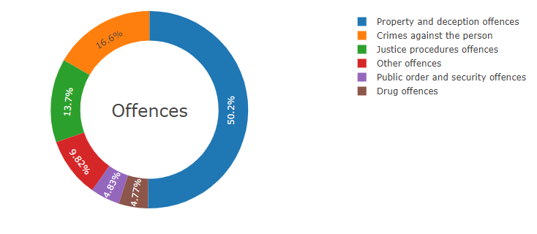
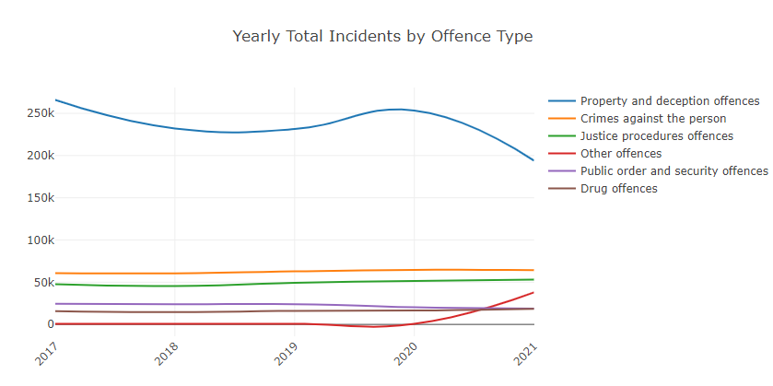
CRIME INCIDENTS BY OFFENCE TYPES
Most common Crime
Incidents…
Crimes against the person
Property and deception offences
Drug offences
Public order and security offences
Justice procedures offences
Other Offences
2021 Data Property and Deception Offences: 50.2 %
Slight Decline in Property and deception offences
Increase in Other Offences – including transport/government/miscellaneous offences
Gender:
Notes:
Again, let’s have a look at this group and differences/similarities
Younger median age – reflects the younger profile of this group in the community
More services provided to females than in the general group
Similar to young people, child protection applications are the most dominant type of service
The top LGAs are different from the general group – tend to be regional areas
Predominant service type is grant of aid, similar to young people

Slide 11

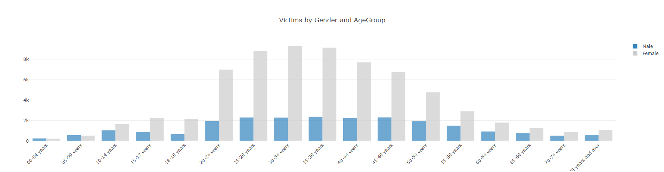
FAMILY INCIDENTS
75%
2021 Data 75% Victims are Females
Age group most subject to Family Violence 30-35 Years
25%
Gender:
Notes:
Unlike ATSI, this profile is older than the general population
Much smaller percentage of services to LOTE females than other categories
Top LGAs tend to be LGAs with higher concentrations of overseas born people
The matter types tend to differ for this group. We see a different range of top matter types, eg. More services in infringement and breaches of family violence in this group (and in ATSI).

Slide 12
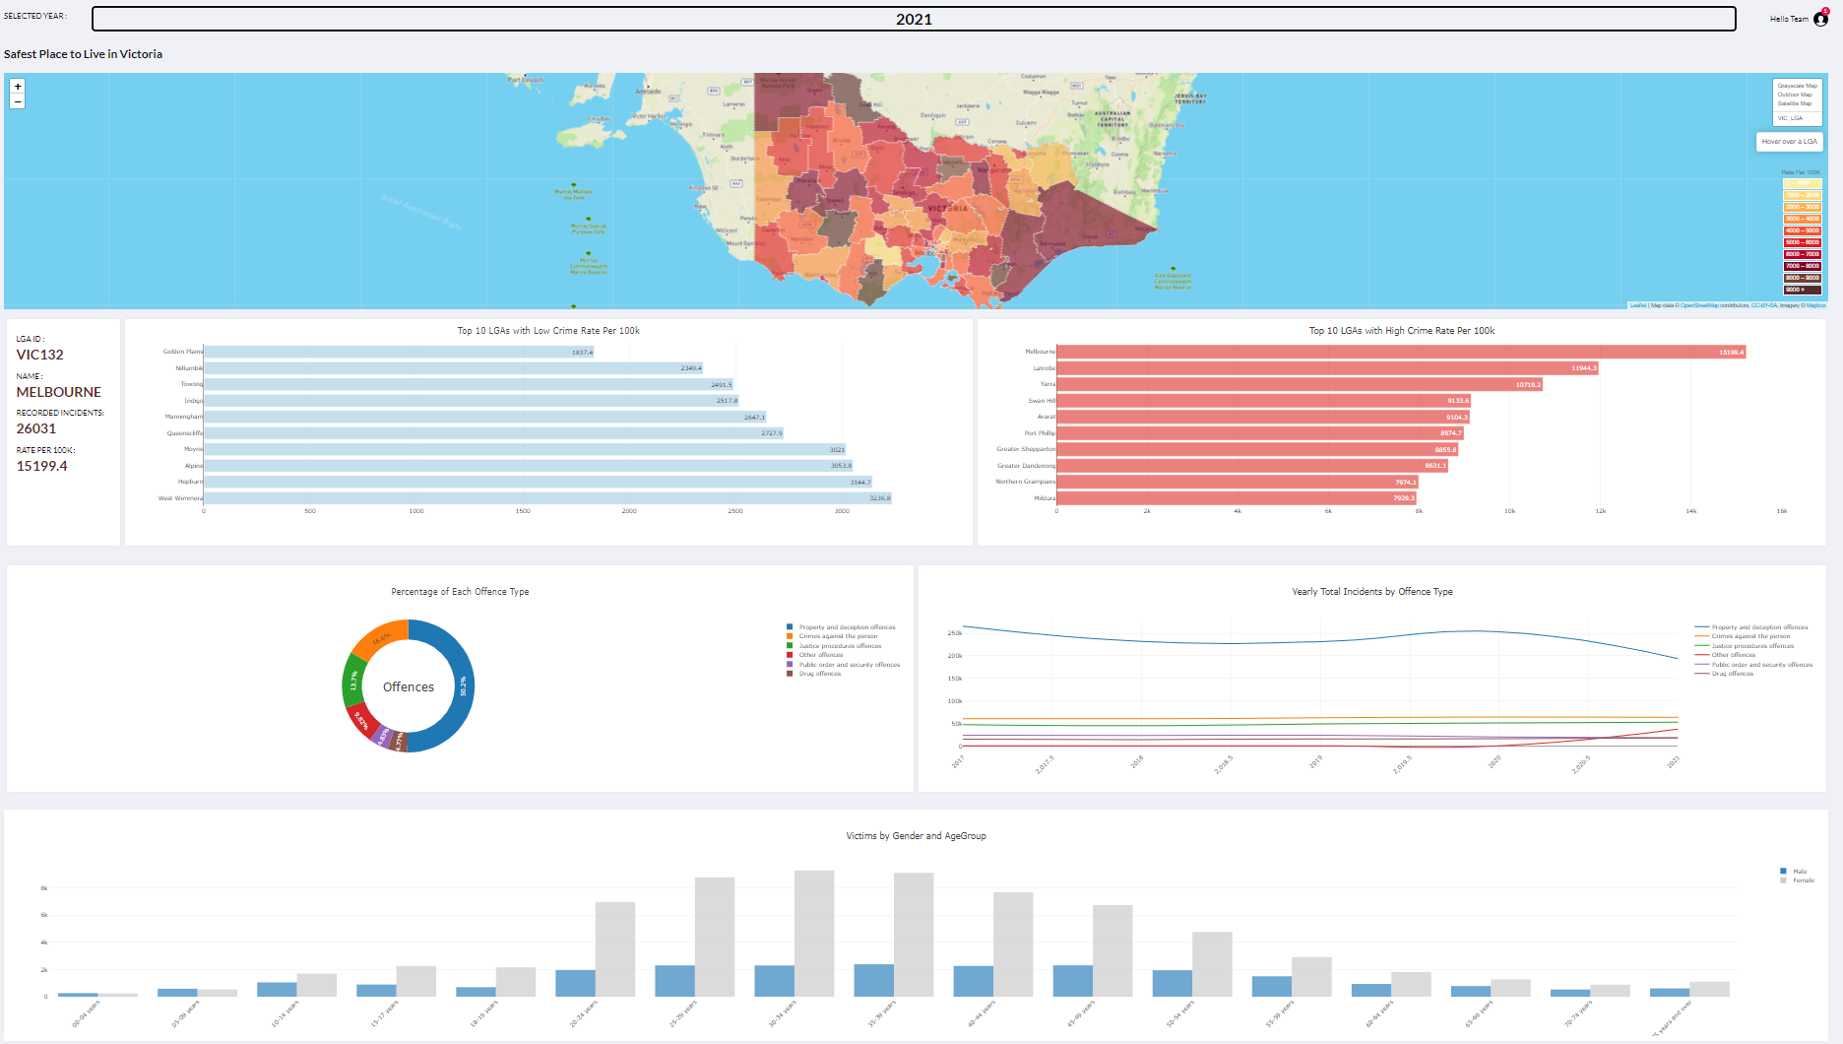
Conclusions AND DASHBOARD DEPLOYMENT
Most common Crime
Incidents…
Crimes against the person
Property and deception offences
Drug offences
Public order and security offences
Justice procedures offences
Other Offences
Notes:
Read slide.

Slide 13
You can view the full report on our website, or contact research@vla.vic.gov.au for more information.

